Slide 1
DemeterBot
SeleneRobotics Inc.
Head of Production: Jordi Del Castillo
Head of Design: Alvin Li
Head of Programming: Brynja Schultz
Final Presentation
EG 1003 Section A3
December 9, 2021
Notes:
*** say mission statement !!!!

Slide 2
Overview
SeleneRobotics
Our Team
Problem Statement
Solution Overview
Project Schedule
Final CAD Drawings
Technical Design Description
Code
Cost Estimate
Video demonstration
Why DemeterBot?

Slide 3

SeleneRobotics
Figure 1: Company Logo
“To autonomously aid the sustainability of the growing human population through innovation”

Slide 4
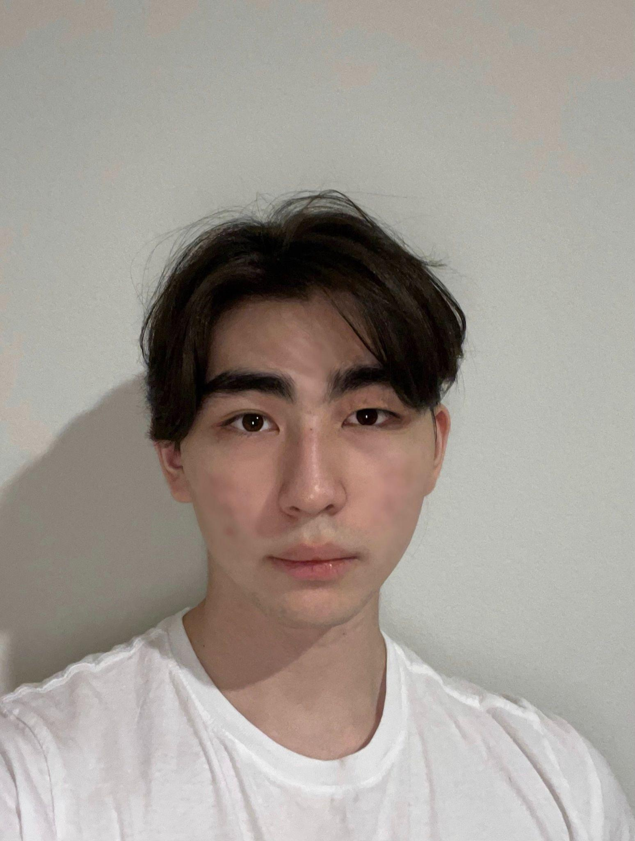

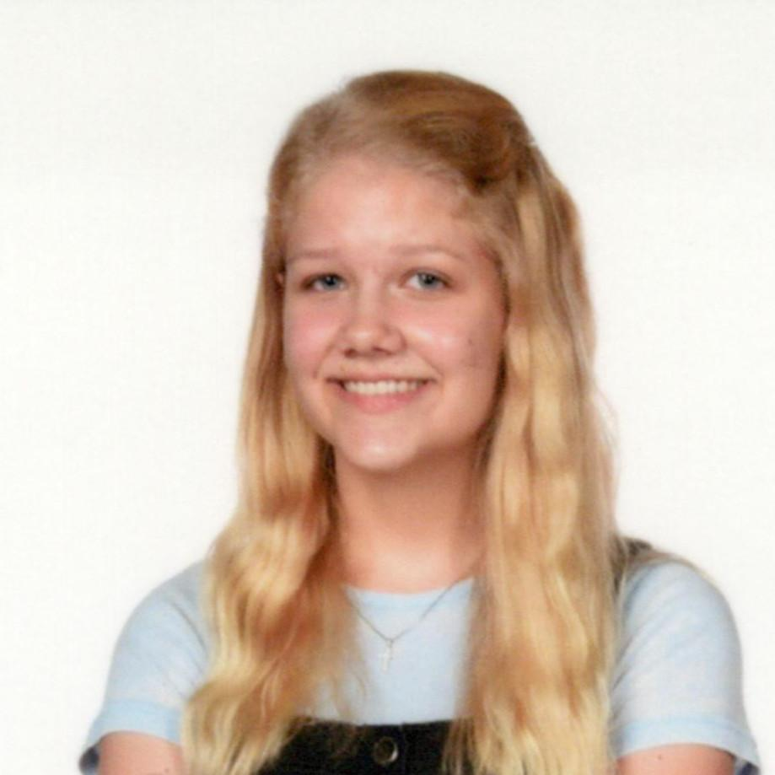
Our Team
Jordi Del Castillo
Head of Production
NYU Tandon 2025
B.S. Computer Science
Lockheed Martin
Alvin Li
Head of Design
NYU Tandon 2025
B.S. Chemical & Biomolecular Engineering
Brynja Schultz
Head of Programming
NYU Tandon 2025
B.S. Computer Science

Slide 5
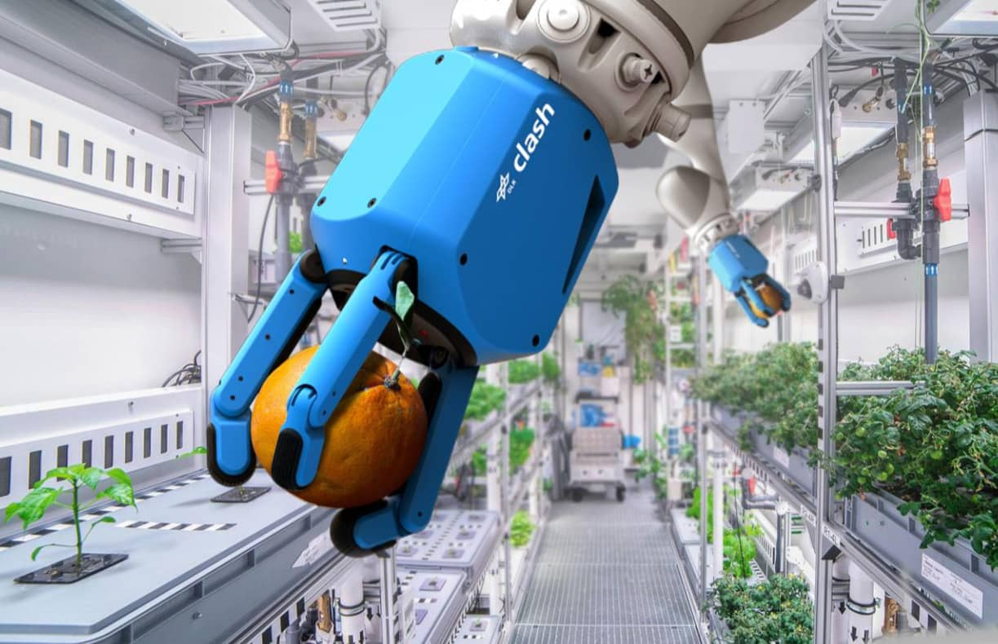
Problem Statement
Overpopulation and food insecurity
Lunar agriculture
NASA Request for Proposal (RFP)
Rover to collect plants
Figure 2: Lunar Greenhouse Agriculture (CNBC)

Slide 6
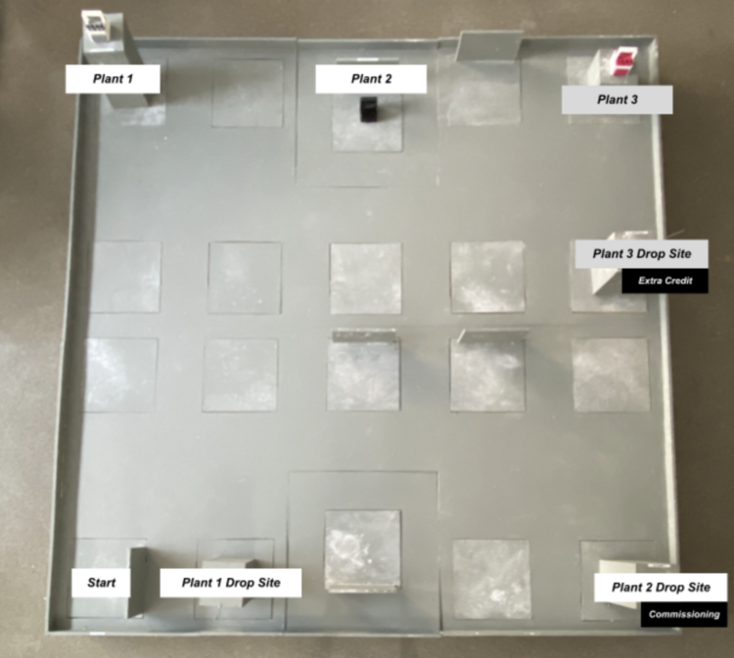
Solution Overview
Design and build a robot to locate and collect plants
  Functional claw
  Ability to traverse the Lunar Agricultural Zone (LAZ)
Figure 3: Lunar Agriculture Zone Layout (NYU Tandon, 2021)

Slide 7
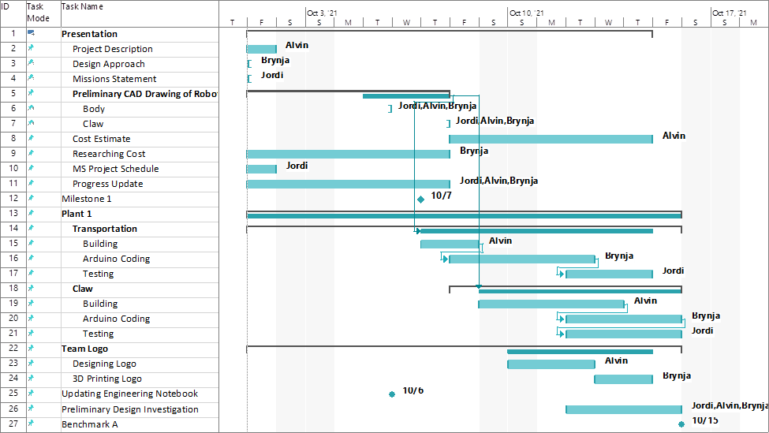
Project Schedule
Figure 4: Stage 1 Schedule

Slide 8
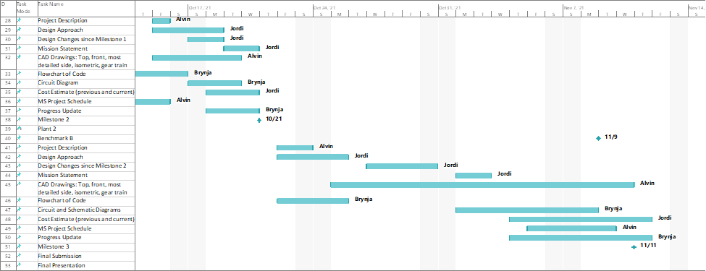
Project Schedule
Figure 5: Stage 2 Schedule

Slide 9
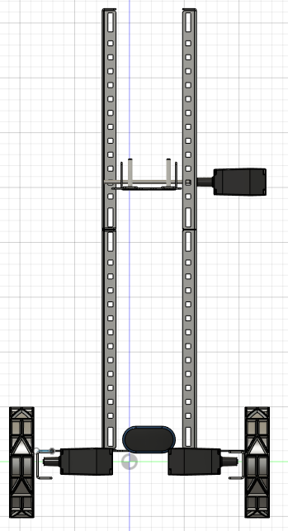
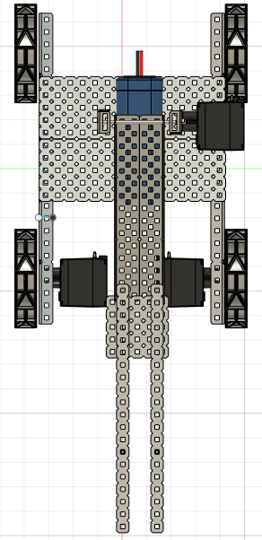
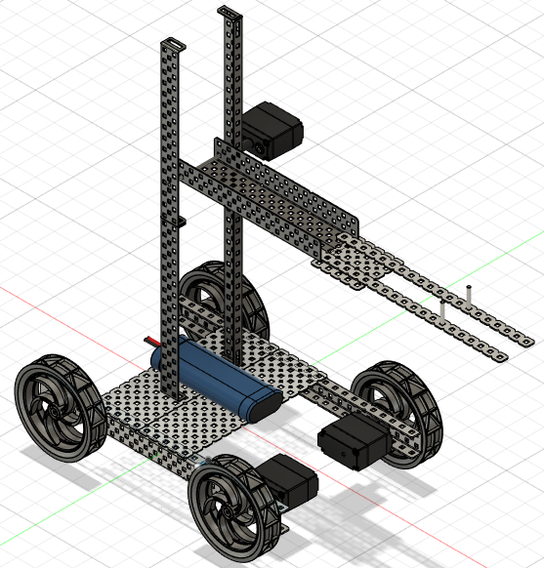
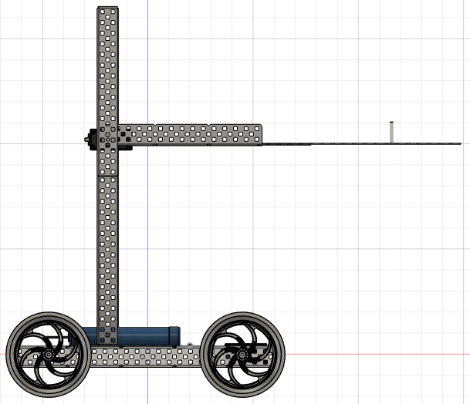
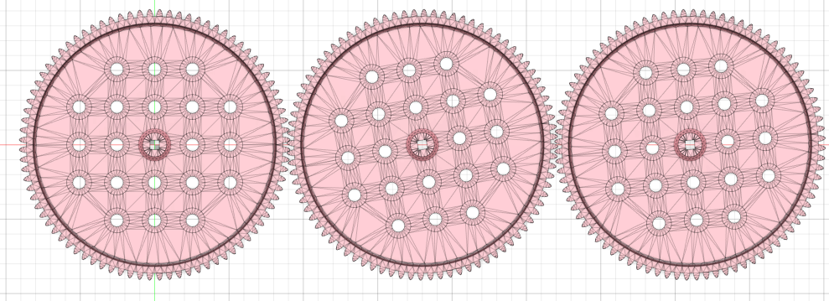
Final CAD Drawings
Figures 6-10: Front, Top, Most Detailed Side, Isometric, Gear Train

Slide 10
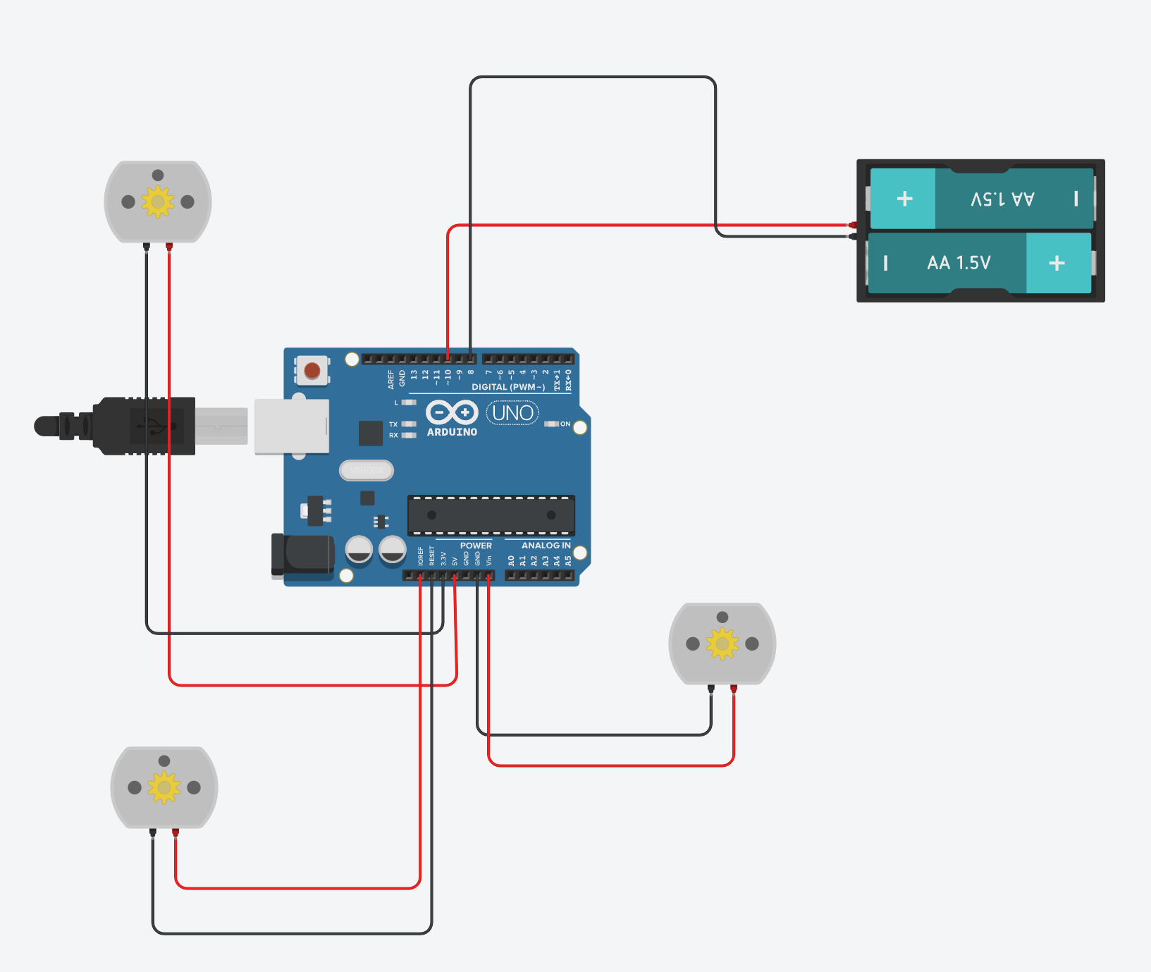
Technical Design Description
Three motors
Battery
Figure 11: Circuit Diagram of DemeterBot

Slide 11
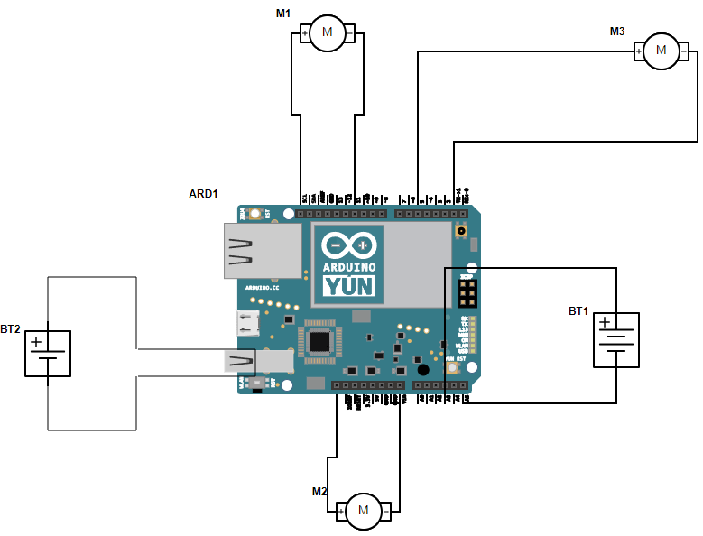
Technical Design Description
Driver Motor 1
Lift Motor
Arduino Battery
Motor Battery
Figure 12: Schematic Diagram
Driver Motor 2

Slide 12
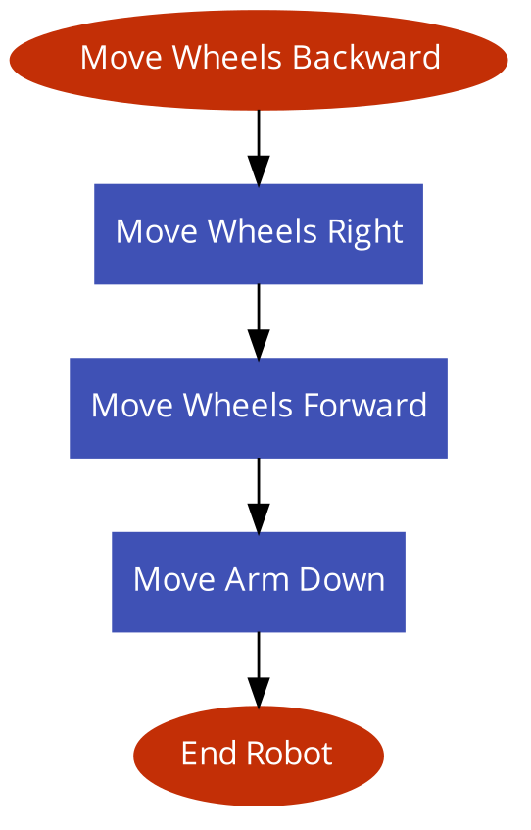
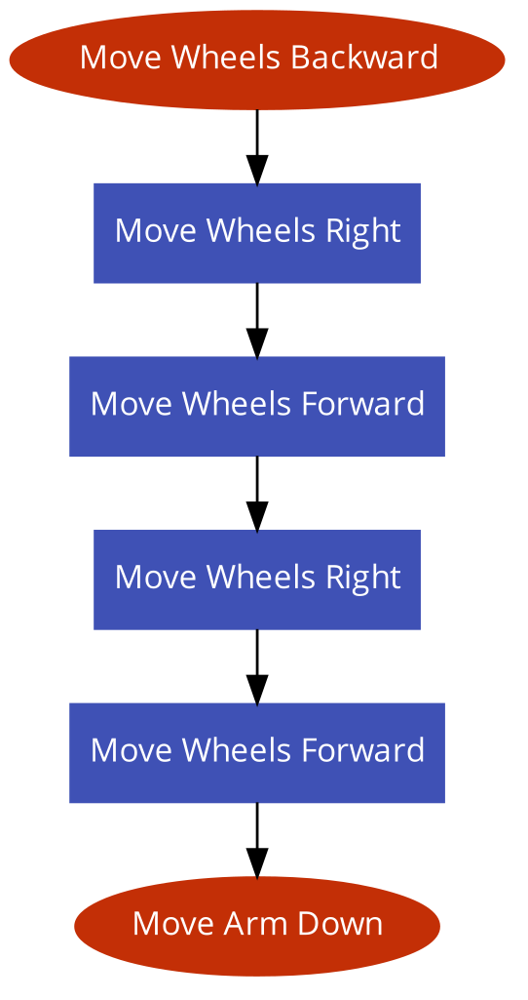
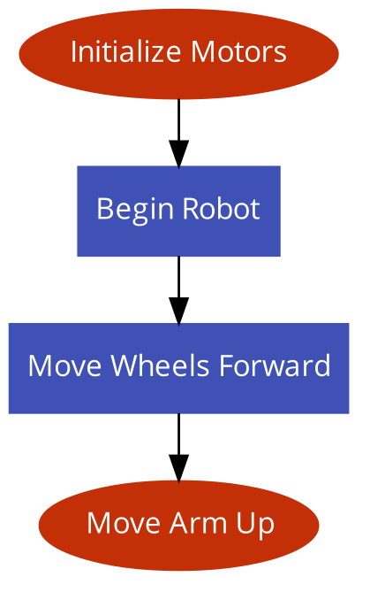
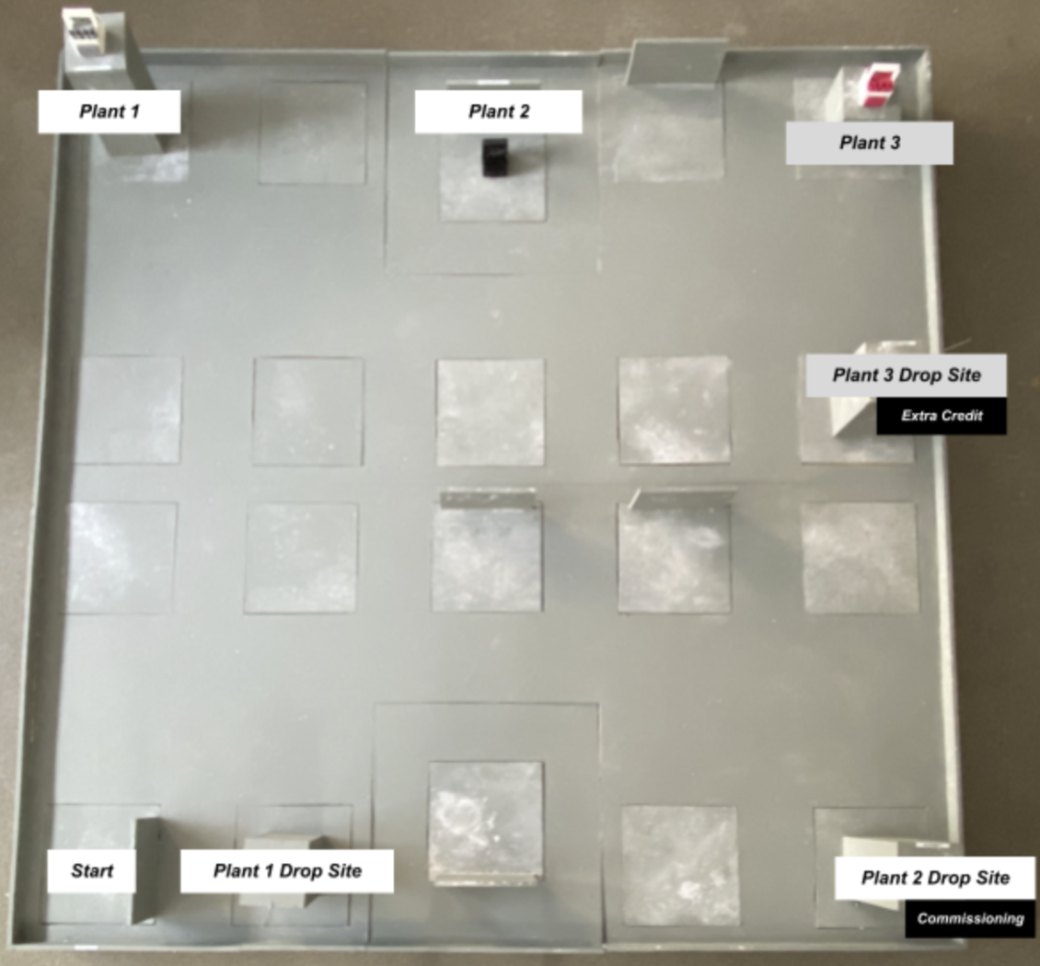
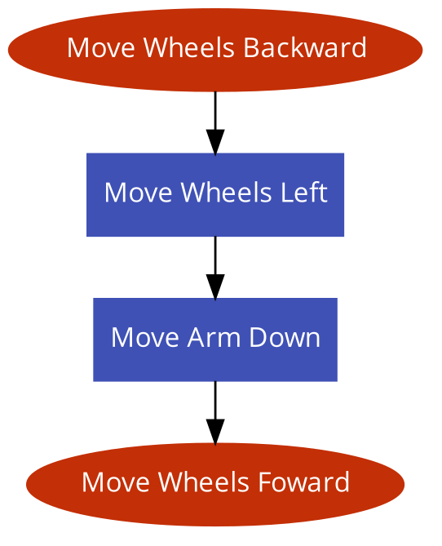

Code
Figure 13: DemeterBot Route

Slide 13
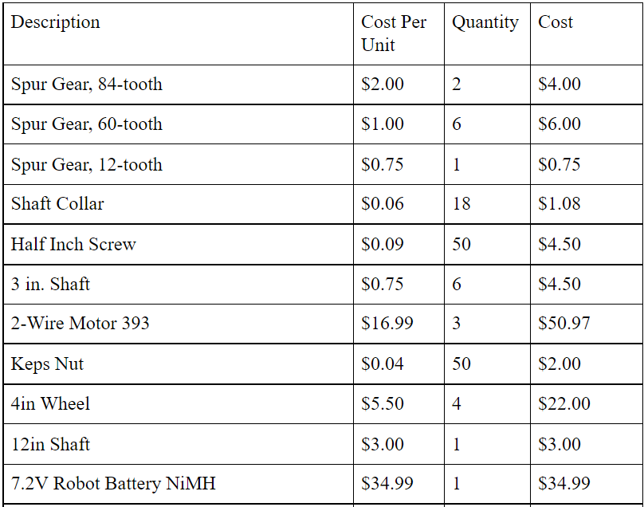
Cost Estimate
Table 1: Cost Estimate

Slide 14
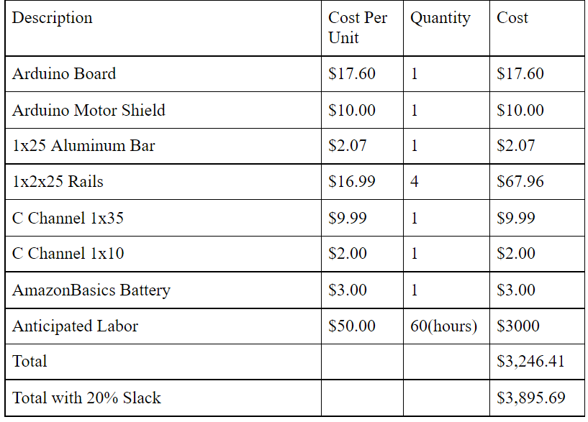
Cost Estimate
Table 2: Cost Estimate

Slide 15

Video Demonstration

Slide 16
Why DemeterBot?
Easy to Build
Only 3 motors
Simple, effective arm design
Less materials
Advantage in transporting, building process, and cost
Minimal Design
1
2
3
Fulfills Requirements
RFP satisfied with minimum materials and cost

Slide 17
Works Cited
NYU Tandon School of Engineering. 2019. “Lunar Agricultural Zone (LAZ)” Accessed 5 October 2021 from https://www.eg.manual.poly.edu

Slide 18
DemeterBot
SeleneRobotics Inc.
Head of Production: Jordi Del Castillo
Head of Design: Alvin Li
Head of Programming: Brynja Schultz
Final Presentation
EG 1003 Section A3
December 9, 2021
Notes:
*** say mission statement !!!!

